Slide 1
More Linked List Operations
EECS 233

Slide 2
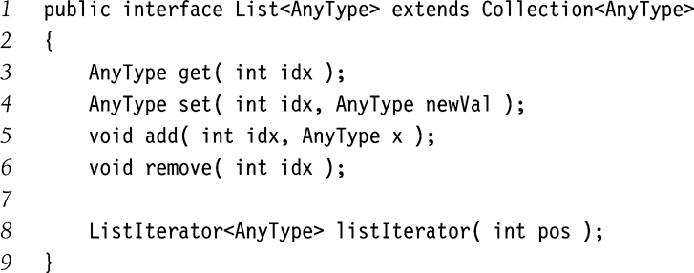
Sanity Check
head
‘f’
‘o’
‘x’
Implements List??
null
  public class LLString {
  private StringNode head;
    private int theSize;
    public char get (int idx){
    …
    }
    ….
    }
  class StringNode {
    private char ch;
    private StringNode next;
    …
  }

Slide 3
Arrays versus Linked Lists
Two implementations of list ADT
Array implementation
  Compact
  Efficient random access (using index)
  Inefficient insert/delete operations
  Need to preallocate maximum size
  Spare room overhead
Link list implementation
  + Efficient insert/delete (for doubly linked lists)
  Easy to grow/shrink
  Random access takes O(N) running time
  Space overhead for the links field
Singly-linked lists versus doubly-linked lists

Slide 4
toUpperCase()
heap storage
stack storage
lst_head
‘f’
‘o’
‘x’
null
trav
toUpperCase(str): converting str to all upper-case letters
private static void toUpperCase(StringNode str) {
StringNode trav = str;
while (trav != null) {
if (trav.ch >= 'a' && trav.ch <= 'z')
trav.ch += ('A' – 'a');
trav = trav.next;
}
}

Slide 5
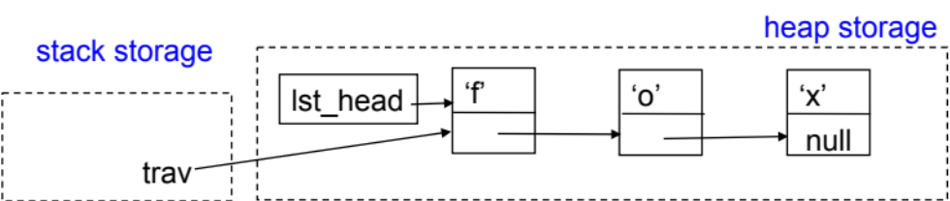
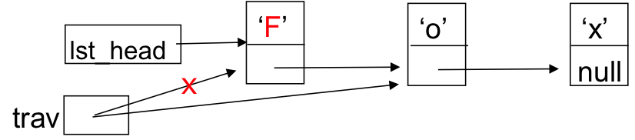
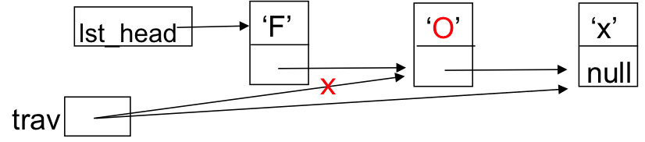
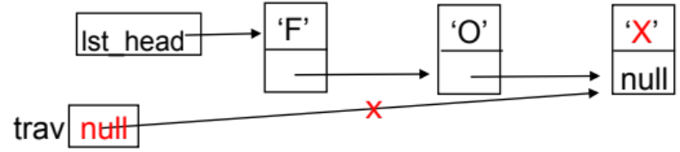
Tracing toUpperCase()
After the first iteration in the while loop
After the second iteration:
After the third iteration
Now trav == null, so we break out of the loop and return from toUpperCase(). The changes are already reflected in the linked list.
private static void toUpperCase(StringNode str) {
StringNode trav = str;
while (trav != null) {
if (trav.ch >= 'a' && trav.ch <= 'z')
trav.ch += ('A' – 'a');
trav = trav.next;
}
}

Slide 6
Traversing A Linked List
Common operation for many tasks.
Can be done using recursion or iteration.
We make use of a variable (call it trav) that keeps track of where we are in the linked list (a simple linked list here).
Template for traversing an entire linked list:
  trav = head; // start with the first node
  while (trav != null) {
    … // usually do something here
    trav = trav.next; // move trav down one node
    }
head
‘f’
‘o’
‘x’
null
trav

Slide 7
Duplicating A Singly Linked List
‘S’
‘O’
‘X’
Helper method copy(str):
  Take the starting StringNode
  Copy all elements through the end
  Return the first element of the new list
Recursive implementation:
  Base case: if str is empty, return null
  Recursion: copy the first character and then make a recursive call to copy the rest
Preliminaries: StringNode constructor
Class StringNode {
    private char ch;
    private StringNode next;
    public StringNode(char myCh){
    ch = myCh;
    next = null;
    }
    …
  }
str
null

Slide 8
Duplicating A Simple Linked List
str
‘S’
‘O’
‘X’
null
Recursive method to copy(str)
private static StringNode copy(StringNode str) {
    if (str == null) // base case
      return null;
    // create the first node, copying the first character into it
    StringNode copyFirst = new StringNode(str.ch);
    // make a recursive call to get a copy of the rest and
    // store the result in the first node’s next field
    copyFirst.next = copy(str.next);
    return copyFirst;
  }

Slide 9
private static StringNode copy(StringNode str) {
if (str == null) return null;
StringNode copyFirst = new StringNode(str.ch);
copyFirst.next = copy(str.next);
return copyFirst;
  }
‘S’
‘O’
‘X’
In the first call:
str
null
‘S’
Finally return this
copyFirst
null
‘O’
‘X’
str
null
In the second call:
‘O’
copyFirst
null
‘X’
str
null
In the third call:
‘X’
copyFirst
null
null
The fourth call reaches the base case and returns “null” :

Slide 10
General Traversal Support: Iterators
Example: count the number of times that an item ‘o’ appears in a list.
One possible implementation: use public LLString methods
  public class MyClass {
    public static int numOccur(LLString str, char ch) {
      int numOccur = 0;
      for (int i = 0; i < str.length(); i++) {
      if (ch == str.get(i))
      numOccur++;
      }
      return numOccur;
    } …
length() and get() are defined public methods in LLString
What is the running time of get(), and what is that of numOccur()? O(?)
lst_head
‘F’
‘o’
‘x’
‘i’
‘n’
‘s’
‘o’
‘x’
null

Slide 11
Solution 1: Make numOccur() an LLString Method
  public class LLString {
    public int numOccur(char ch) {
      int numOccur = 0;
      StringNode trav = lst_head;
      while (trav != null) {
        if (trav.ch == ch)
        numOccur++;
        trav = trav.next;
      }
      return numOccur;
    } …
Number of accesses = ? O(?)
Problem: we can’t anticipate all of the types of operations that users may wish to perform.
We would like to give users the general ability to iterate over the list.
public class MyClass {
public int numOccur(LLString str, char ch) {
return str.numOccur(ch);
}
    …
}

Slide 12
Solution 2: Give Access to the Internals of the List
Make StringNode visible
Provide public “get” methods
  getNode(i) in LLString
  getNext() in StringNode
This would allow us to do the following:
  public class MyClass {
    public static int numOccur(LLString str, char ch) {
      int numOccur = 0;
      StringNode trav = str. getNode(0);
      while (trav != null) {
        char c = trav. getChar();
        if (c == ch)
        numOccur++;
        trav = trav. getNext();
      }
      return numOccur;
    } …
Makes numOccur dependent on implementation of the list!

Slide 13
Solution 3: Provide an Iterator
An iterator is an object that provides the ability to iterate over a list without violating encapsulation.
Our Iterator class will have two methods:
  // Are there more items to visit?
  boolean hasNext()
  // Return next item and advance the iterator.
  char next()
A newly created Iterator object starts out prepared to access the first item in the list, and we use next() to access the items sequentially.
Example: position of the iterator is shown by the cursor symbol (|)
  after the iterator i is created: | “F” “O” “X” …
  after calling i.next(), which returns “F”: “F” | “O” “X” …
  after calling i.next(), which returns “O”: “F” “O” | “X” …

Slide 14
A List Iterator Class
Iterator state
  Keeping cursor position: instance variable “nextNode”
Any Iterator object is associated with a given LLString object
Must allow access from Interator to the internals of the associated LLString object
Multiple iterator objects can be created for the same LLString object

Slide 15
A List-Iterator as Inner Class
Iterator state
  Cursor: instance variable “nextNode”
Any Iterator object is associated with a given LLString object
  Make Iterator class an inner class of LLString
  Allows access from Interator to the internals of the associated LLString object
Multiple iterator objects can be created for the same LLString object
Iterator as an inner class.
  public class LLString {
    private StringNode head;
    private StringNode tail;
    …
    public Iterator iterator(){
    Iterator iter = new Iterator();
    return iter;
    }
  }
Creation:
public class Iterator {
private StringNode nextNode;
private Iterator (){
nextNode = head;
}
  public boolean hasNext() {…}
  public char next() {…}
…
}
LLString.Iterator myIter1 = string.iterator();
LLString.Iterator myIter2 = string.iterator();

Slide 16
Internals of the Iterator Class
Two methods are provided in Iterator class:
  public boolean hasNext() {
    return (nextNode != null);
  }
  public char next() {
    if (nextNode == null)
      throw new Exception(“Falling off the list end”);
    char ch = nextNode.ch;
    nextNode = nextNode.next;
    return ch;
  }
next() does two things:
  it returns the character stored in the current node
  it advances the iterator so that it is ready to access the next node

Slide 17
numOccur() Using an Iterator
  public class MyClass {
  public static int numOccur(LLString str, char ch) {
      int numOccur = 0;
      LLString.Iterator iter = str.iterator();
      while (iter.hasNext()) {
        char c = iter.next();
        if (c == ch)
        numOccur++;
      }
      return numOccur;
    }
    …
  }
The method is outside the LLString class, but it's able to iterate over the characters in the list efficiently without violating encapsulation
  No usage of StringNode objects
  Does not depend on LLString internals

Slide 18
Code Reuse
  public interface StrIterator{
  char next();
  boolean hasNext();
  …
  }
  public interface StrList {
    void add(int idx, char x);
    void remove(int idx);
    StrIterator iterator();
    …
  }
  public class StrArrayList implements StrList {
    public add(int idx, char x){ ... }
    …
    public StrIterator iterator(){…}
    private class StrArrIterator
    implements StrIterator{
    private StrArrIterator(){…}
    …
    }
  }
  public class StrLinkedList implements StrList {
    public add(int idx, char x){…}
    …
    public StrIterator iterator(){…}
    private class StrLLIterator
    implements StrIterator{
    private StrLLIterator(){…}
    …
    }
  }
  public class Demo {
  public static int numOccur(StrList str, char ch) {
  int numOccur = 0;
  StrIterator iter = str.iterator();
  while (iter.hasNext()) {
  char c = iter.next();
  if (c == ch)
  numOccur++;
  }
  return numOccur;
  }
  }
  public static void main( String [] arg){
  StrArrayList string1 = new StrArrayList(“cat”};
  StrLinkedList string2 = new StrLinkedList(“puppy”);
  if (numOccur(string1, “c”) < numOccur(string2, “p”){
  ….
  }
  }

Slide 19
Java Support for Iterators
Java’s built-in collection classes all support iterators.
  Java’s Iterator classes are generic
  the built-in Iterator interface (java.util.Iterator<AnyType> and java.util.ListIterator<AnyType>) specifies the iterator methods
  they include hasNext() and next() methods like ours (in addition the remove() method)
  users of an iterator use the interface name as the type of the iterator object:
  ListIterator myCursor = myList.listIterator();

